Slide 1
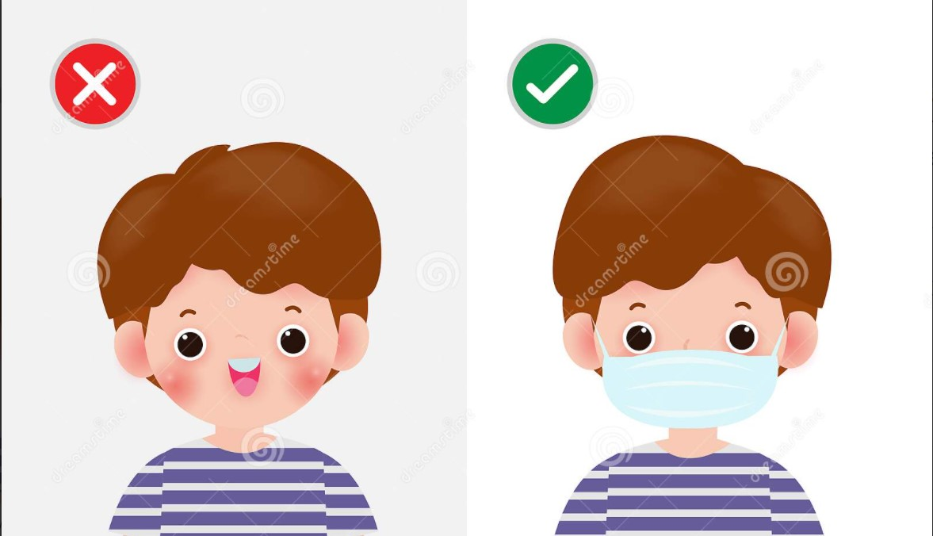


Avishkar - 2022
TITLE
“REAL TIME FACE MASK DETECTION & MENTAL STRESS DETECTION USING FACIAL EXPRESSION.”
Theme Area: Pure Science
Level: PG

Slide 2
INDEX
Objective:-
Introduction:-
Proposed Methodology and Architecture :-
Application:-
Conclusion:-
References:-

Slide 3
Objective:-
We propose a system to detect whether someone is wearing a mask or not in a smart city network.
A real time recognition system that tracks a person's mood and find out he has mental stress or not.
This application used for the purpose of Security- like Track down criminals & terrorist, Authentication-at entrance and Surveillance.
Keywords: OpenCv, Tensorflow, Keras, FaceNet Modal, Haar Cascade Classifier

Slide 4
Introduction
Real Time Face Mask Detection:-
Real Time Face mask detection system to detect face in the real world and then determining whether the wearing a mask or not .
Haar cascade mainly works with face detection. The algorithm requires a lot of training datasets the image which contain faces as positive dataset and images without faces as negative datasets.

Slide 5
Introduction
Real Time Mental Stress Detection:-
I am proposing an application that is capable of determining human emotion.
By Emotion Detection or facial expression, we can find out whether he has mental stress or not. Explanation : If he/she is happy the have no mental stress and if he/she is sad then they have mental stress.

Slide 6
Proposed Methodology & Architecture
Webcam Input
Haar cascade classifier detect input
Image Pre-processing
Display message/beep alert
Identifying persons mask and facial expression
Facenet model architecture
The distance and angle between these points calculates the category of emotion and gives the percentage (ranges from 0to 100) of facial expression on the user’s face.

Slide 7
Applications
Face mask detection refers to detect whether a person is wearing a mask or not. This implementation can be used in various locations and platforms.
Improved security: Face detection improves surveillance efforts and helps track down criminals and terrorists. It can be very effective in the field of military.
Facial recognition is a technology that can benefit society, including increasing safety and security, preventing crimes, and reducing human interaction.

Slide 8
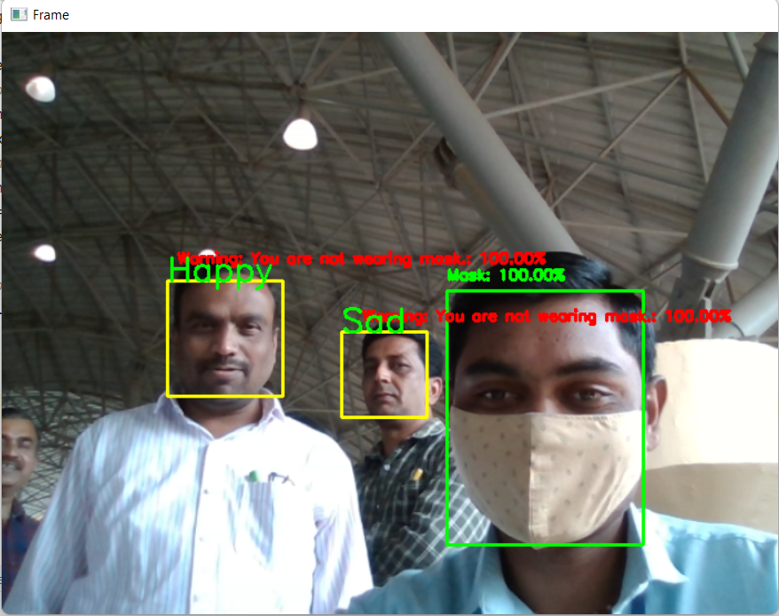
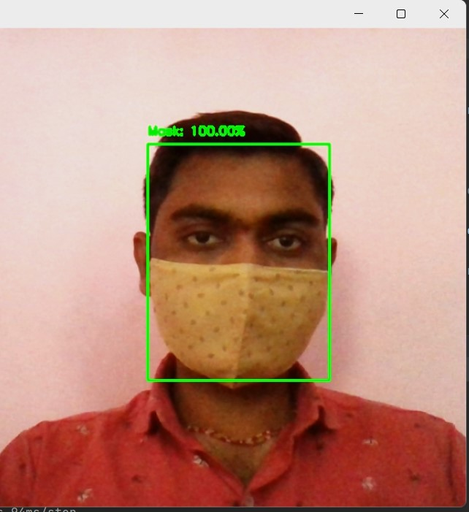
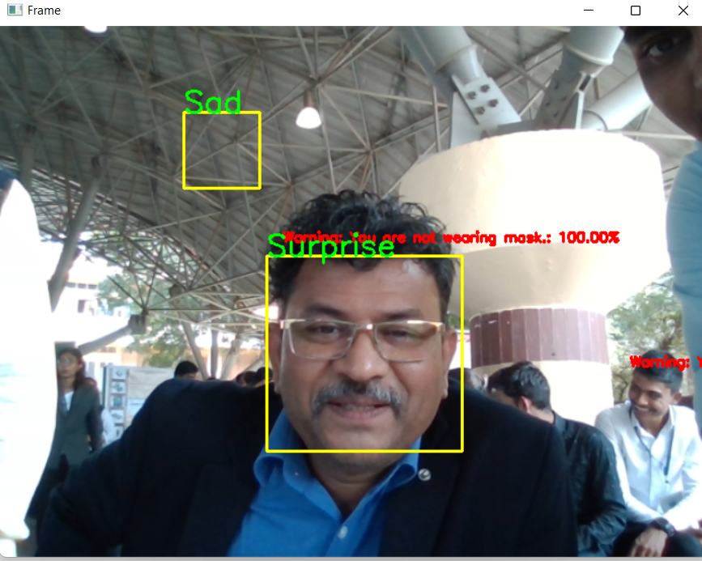
Results

Slide 9
Conclusion:-
As the technology is growing with surging trends, we have a novel face mask detector which can possibly contribute to the public health care department. he/she has mental stress or not he can find out by his emotion.
It can be very effective in the field of Military and for security purpose about terrorism in public area.
For the future, this app can be developed so that it is compatible on multiple platforms. The emotion can be used as an input in order to achieve a variety of outputs based on the requirements.

Slide 10
References:-
https://pyimagesearch.com/2020/05/04/covid-19-face-mask-detector-with-opencvkerastensorflow-and-deep-learning/
https://opencv.org/course-deep-learning-withtensorflow-and-keras/
S. Gupta, “Facial emotion recognition in real time and static images,” Jan. 2018.
B. Qin and D. LI, “Identifying Facemask wearing Condition Using Image Super resolution with Classification Network to Prevent COVID-19”, Research Square platform LLC, May 2020.

Slide 11
Thank You!

